Slide 1



OnPAR

Slide 2



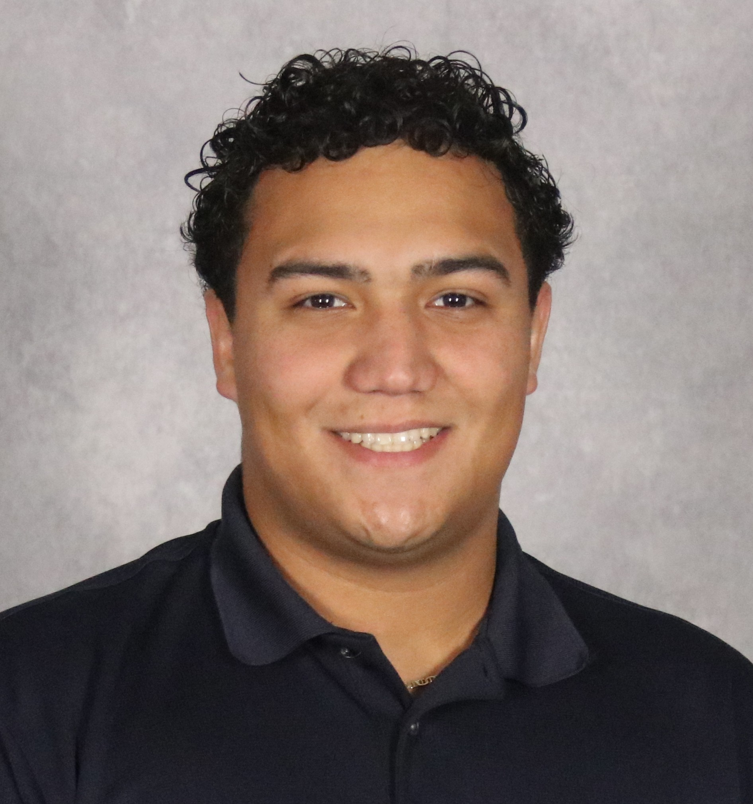


Team Members
Ian Beller (Mobile)
Alex Fowler
(API)
Haresh Palli (Project Manager)
Sebastian Sotomayor
(Database)
Chris Tuckman
(API)
Andres Castro (Frontend)

Slide 3

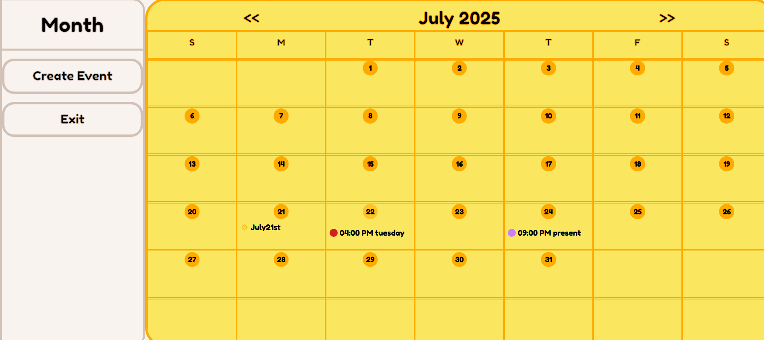

What is OnPAR?
Calendar app
Users can make an account to manage their events
Journal feature for daily reflection

Slide 4











Technology Used

Slide 5

Project Manager
Tasks:
Keep everything organized and on track
Work on various aspects of project
Experience gained:
React, Flutter, API
Team leadership

Slide 6
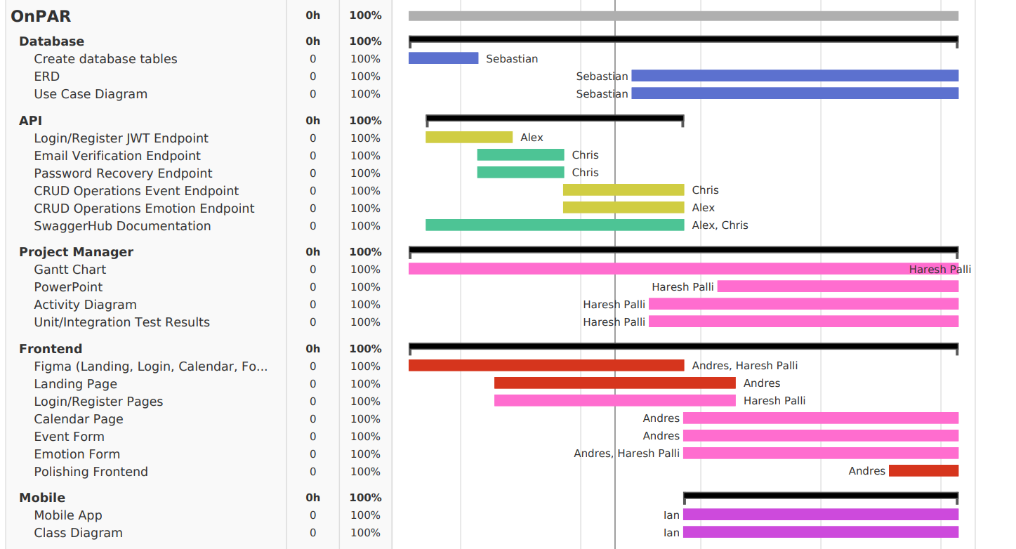
Gantt Chart

Slide 7
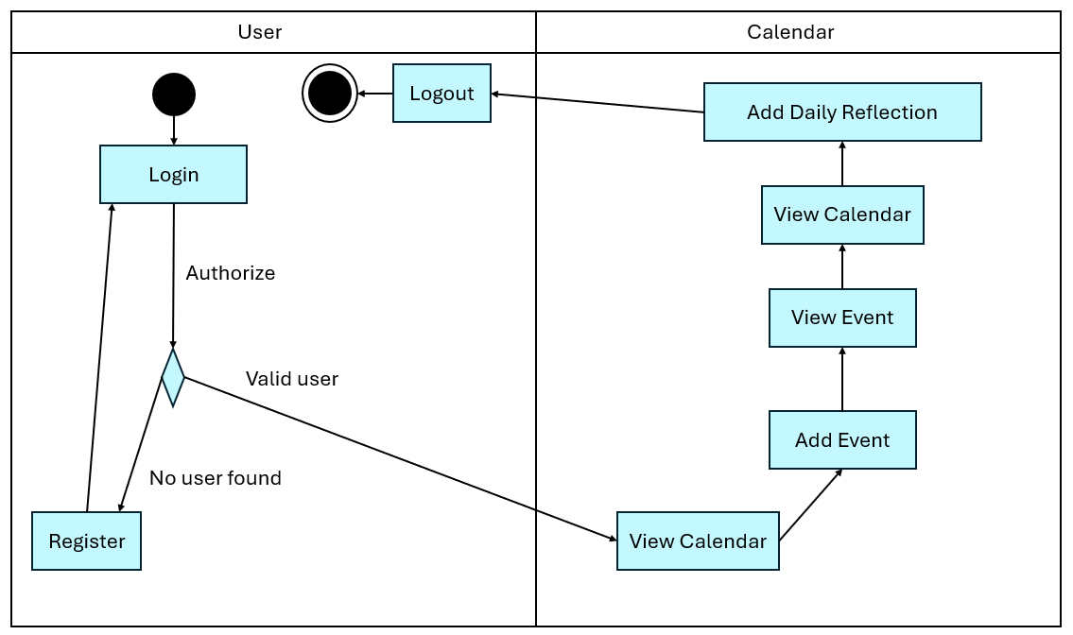
Activity Diagram

Slide 8
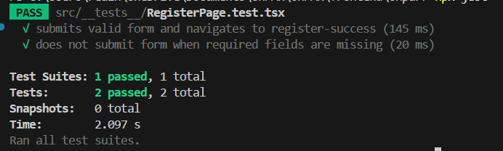
Unit Testing Demonstration

Slide 9

Database
Tasks:
Create database and define schemas
Entity Relationship Diagram
Use Case Diagram
Experience gained:
MongoDB
Node.js, Mongoose library

Slide 10
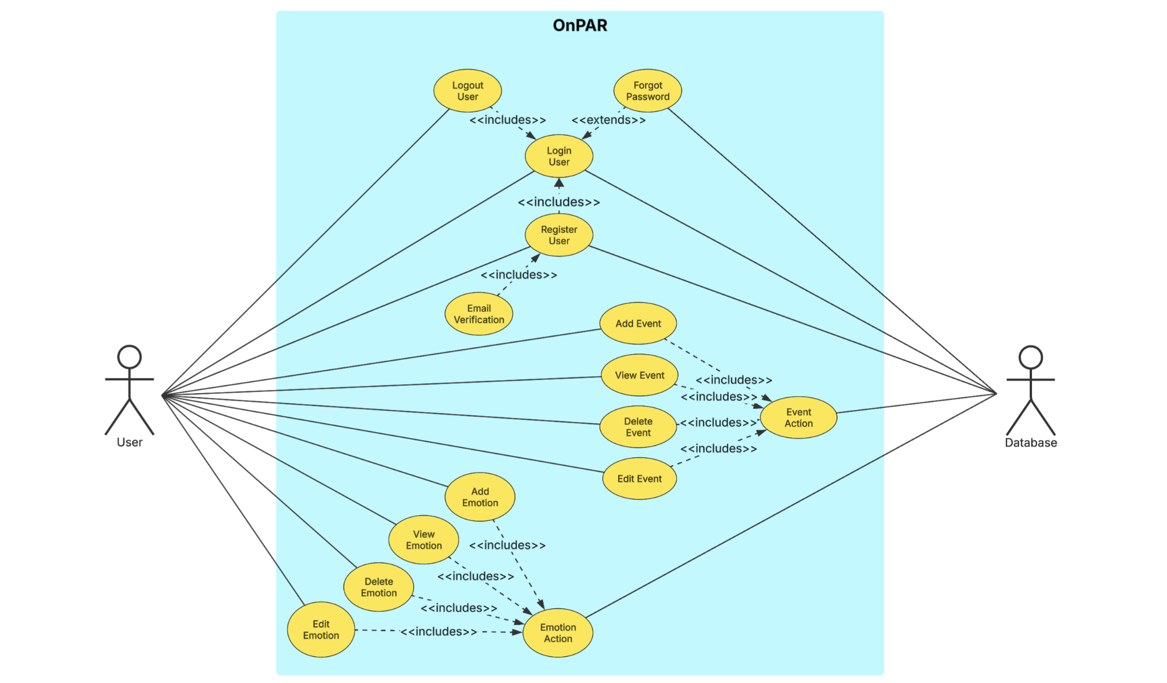
Use Case Diagram

Slide 11
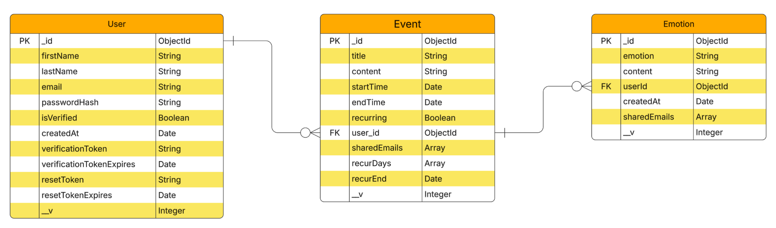
ERD

Slide 12
API
What Went Well ✅
Swaggerhub was intuitive
Good separation of tasks between API members
Lots of documentation for learning Javascript
What Went Wrong ❌
A lot more to learn about Javascript
Setting up email system had some challenges, email went to spam

Slide 13
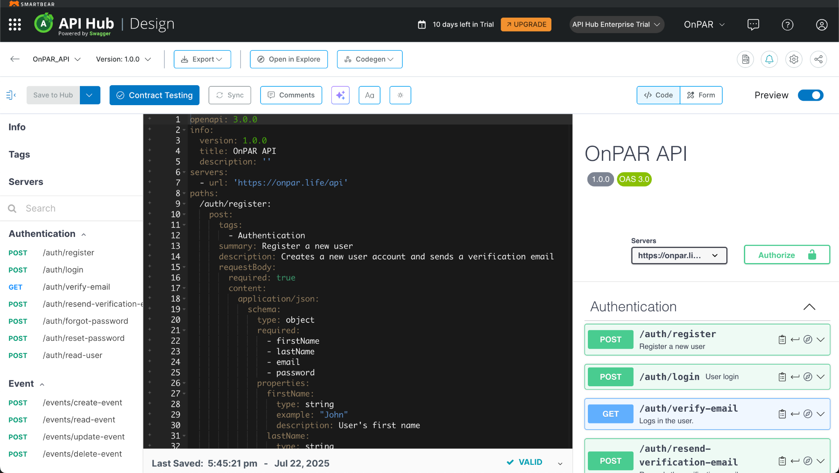
API SwaggerHub Demonstration

Slide 14



Frontend
Tasks:
Create login/register pages
Create calendar/emotion functionality
Create different themes and style website
Experience gained:
React, Tailwind CSS, Figma

Slide 15
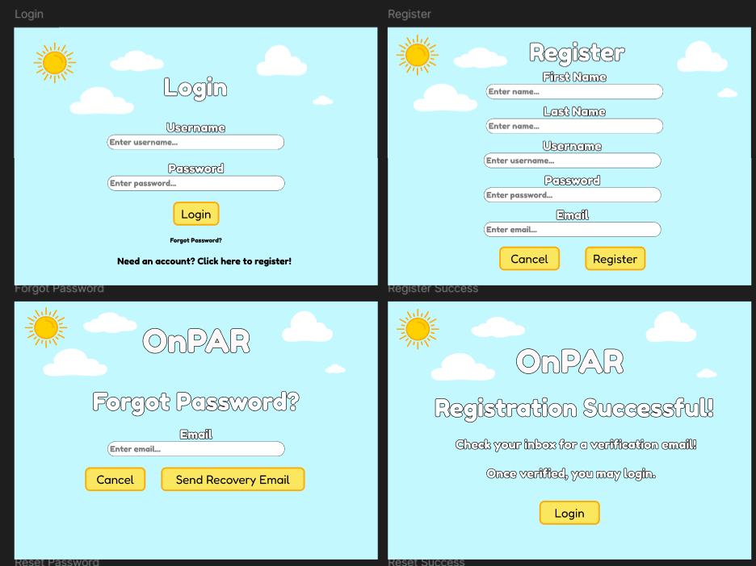
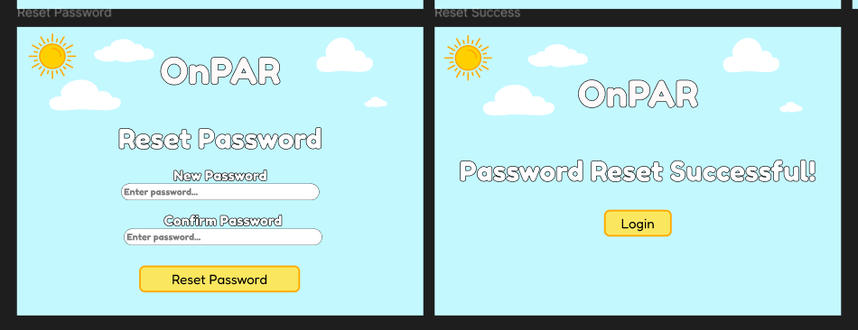

Figma Prototypes

Slide 16
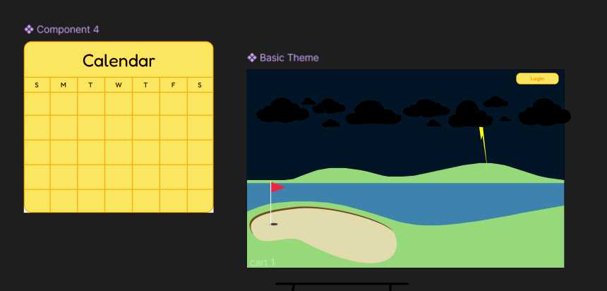
Figma Prototypes

Slide 17


Slide 18

Mobile
Flutter Application that emulated the functionality of the Web Application
Dart was difficult to pick up initially
Worked on function before form
Organization and styling assistance

Slide 19
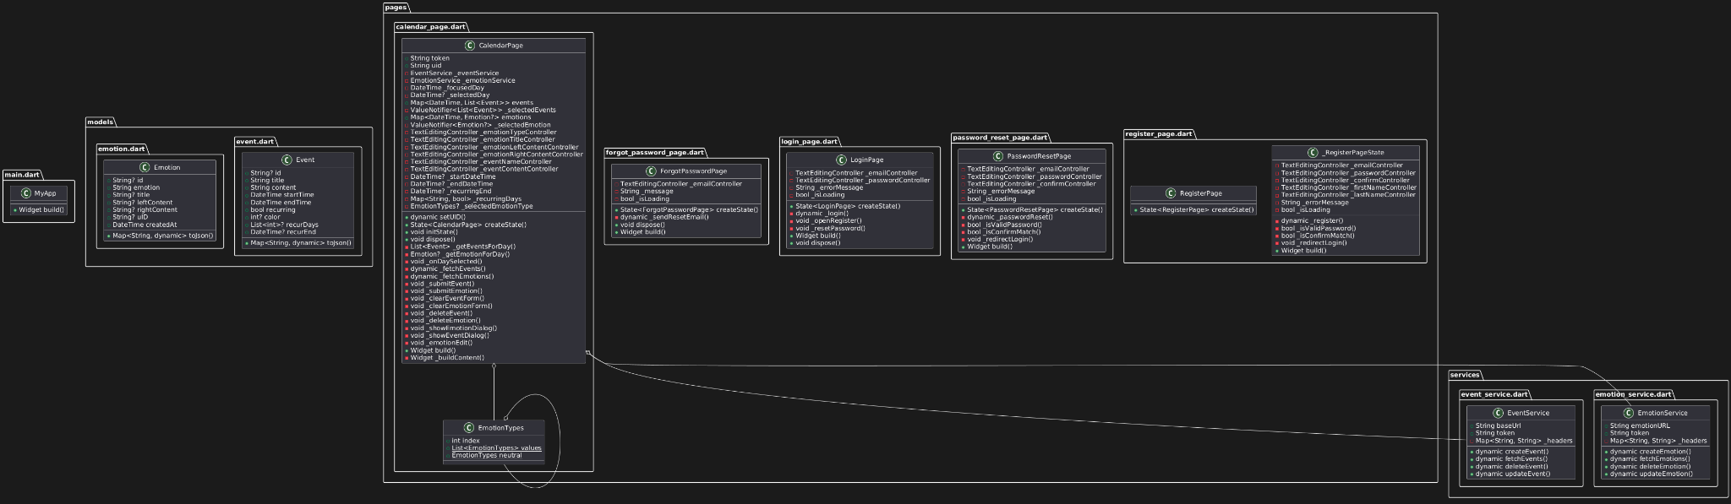
Class Diagram

